Slide 1
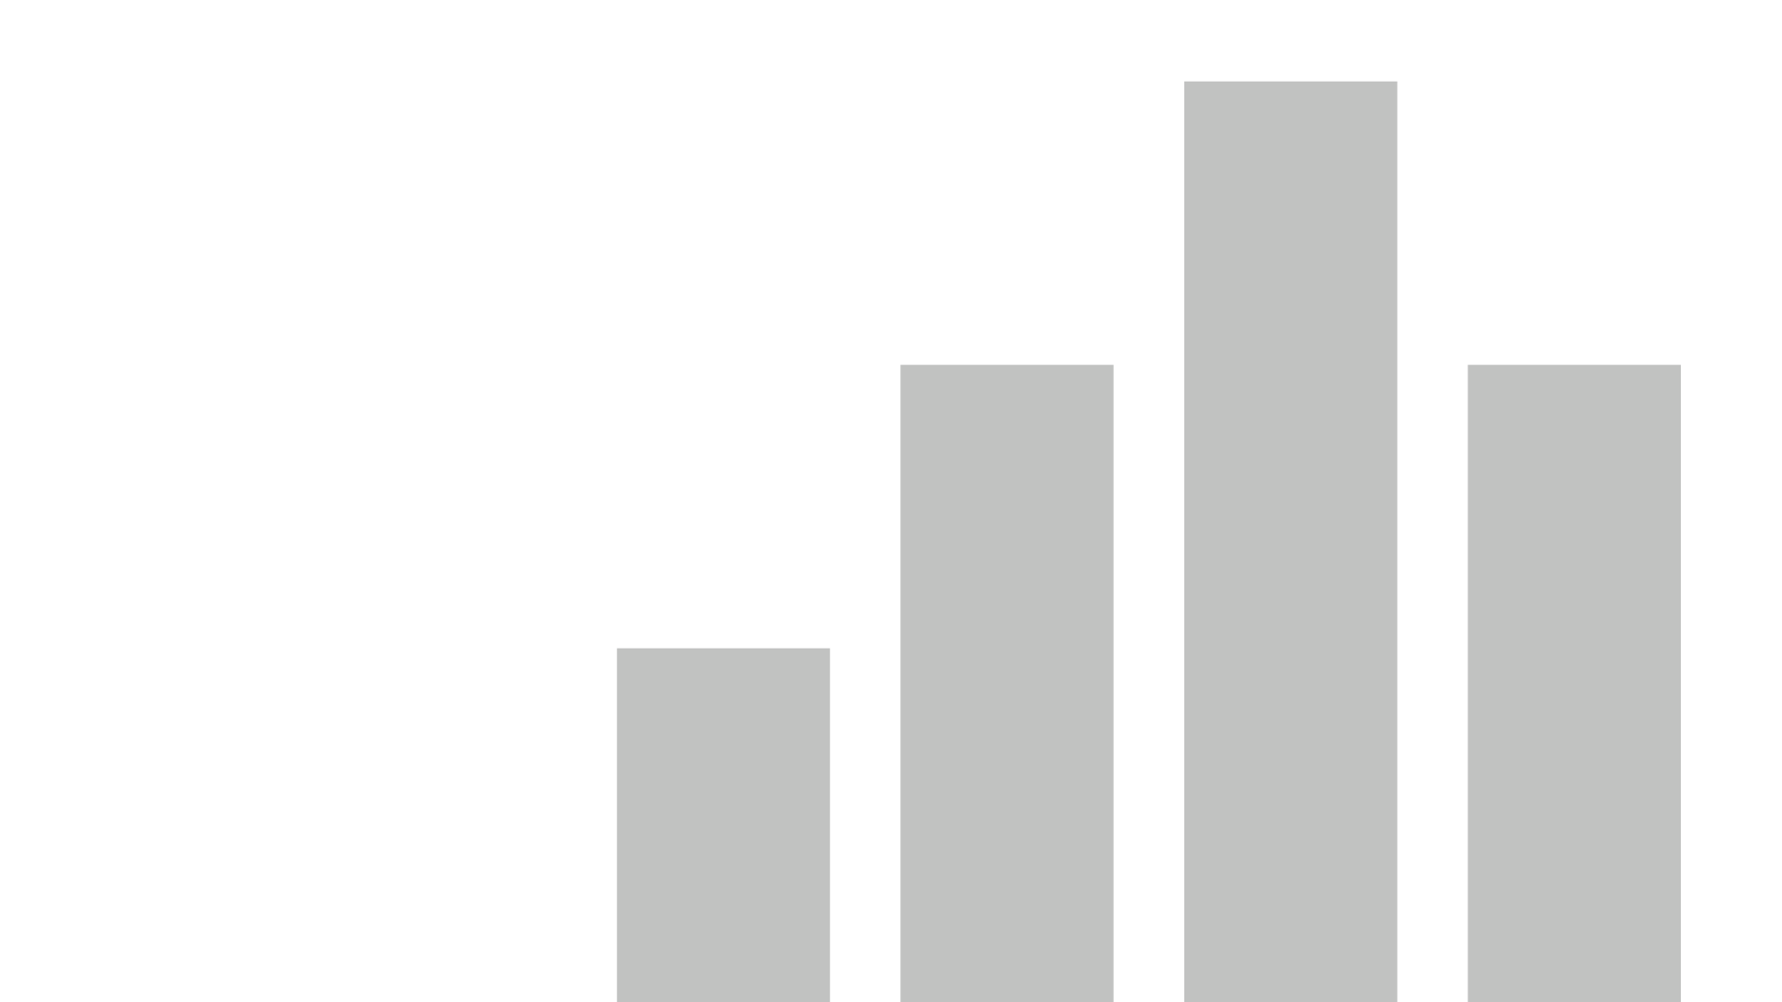

Retail Sales Analysis
Go to the Report

Slide 2
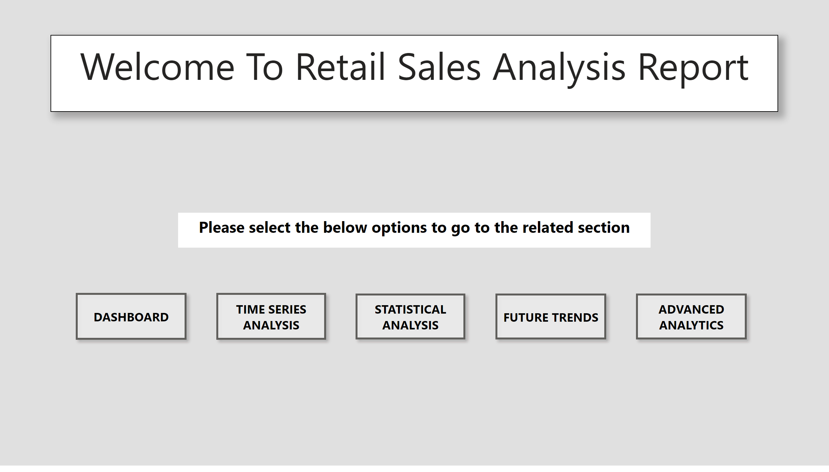
Home
Notes:
textbox
No alt text provided
textbox
No alt text provided
actionButton
No alt text provided
actionButton
No alt text provided
actionButton
No alt text provided
actionButton
No alt text provided
actionButton
No alt text provided

Slide 3
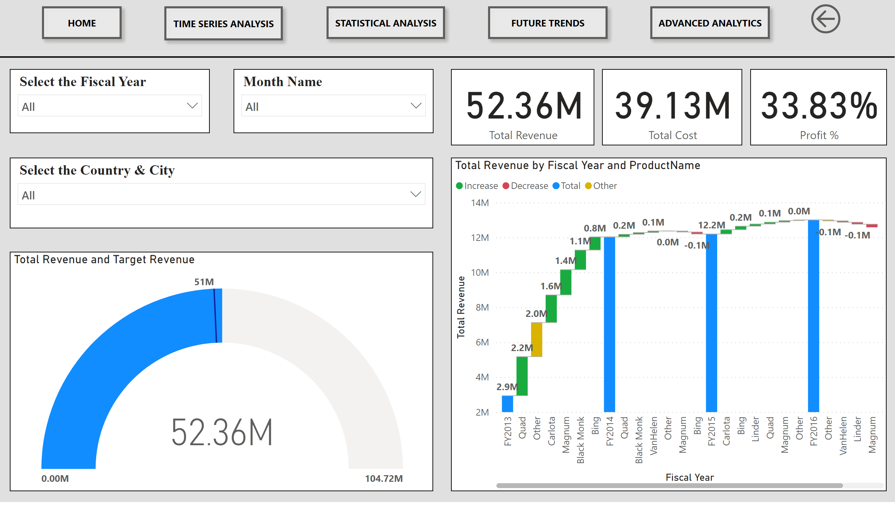
Dashboard
Notes:
actionButton
No alt text provided
actionButton
No alt text provided
actionButton
No alt text provided
actionButton
No alt text provided
actionButton
No alt text provided
actionButton
No alt text provided
shape
No alt text provided
slicer
No alt text provided
slicer
No alt text provided
card
No alt text provided
card
No alt text provided
card
No alt text provided
gauge
No alt text provided
waterfallChart
No alt text provided
slicer
No alt text provided

Slide 4
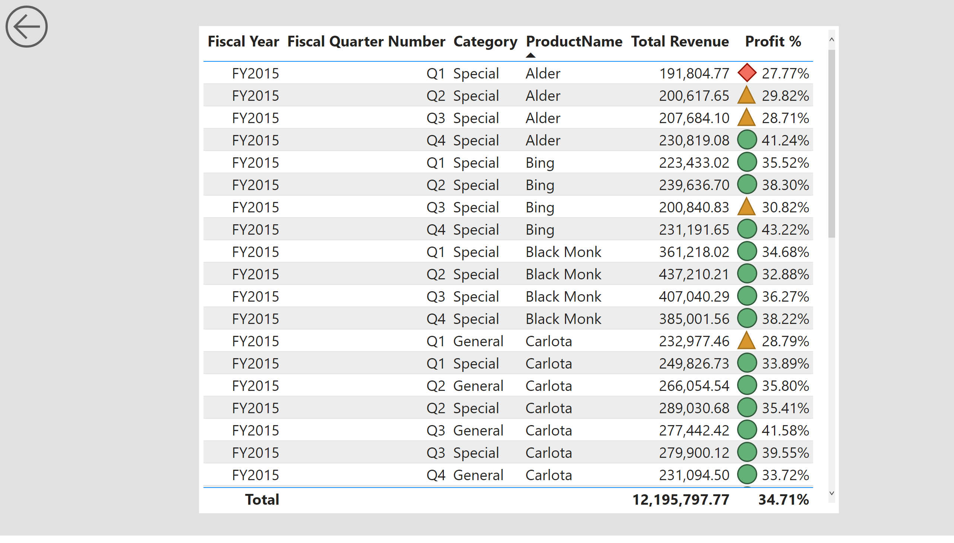
Details
Notes:
tableEx
No alt text provided
actionButton
No alt text provided

Slide 5
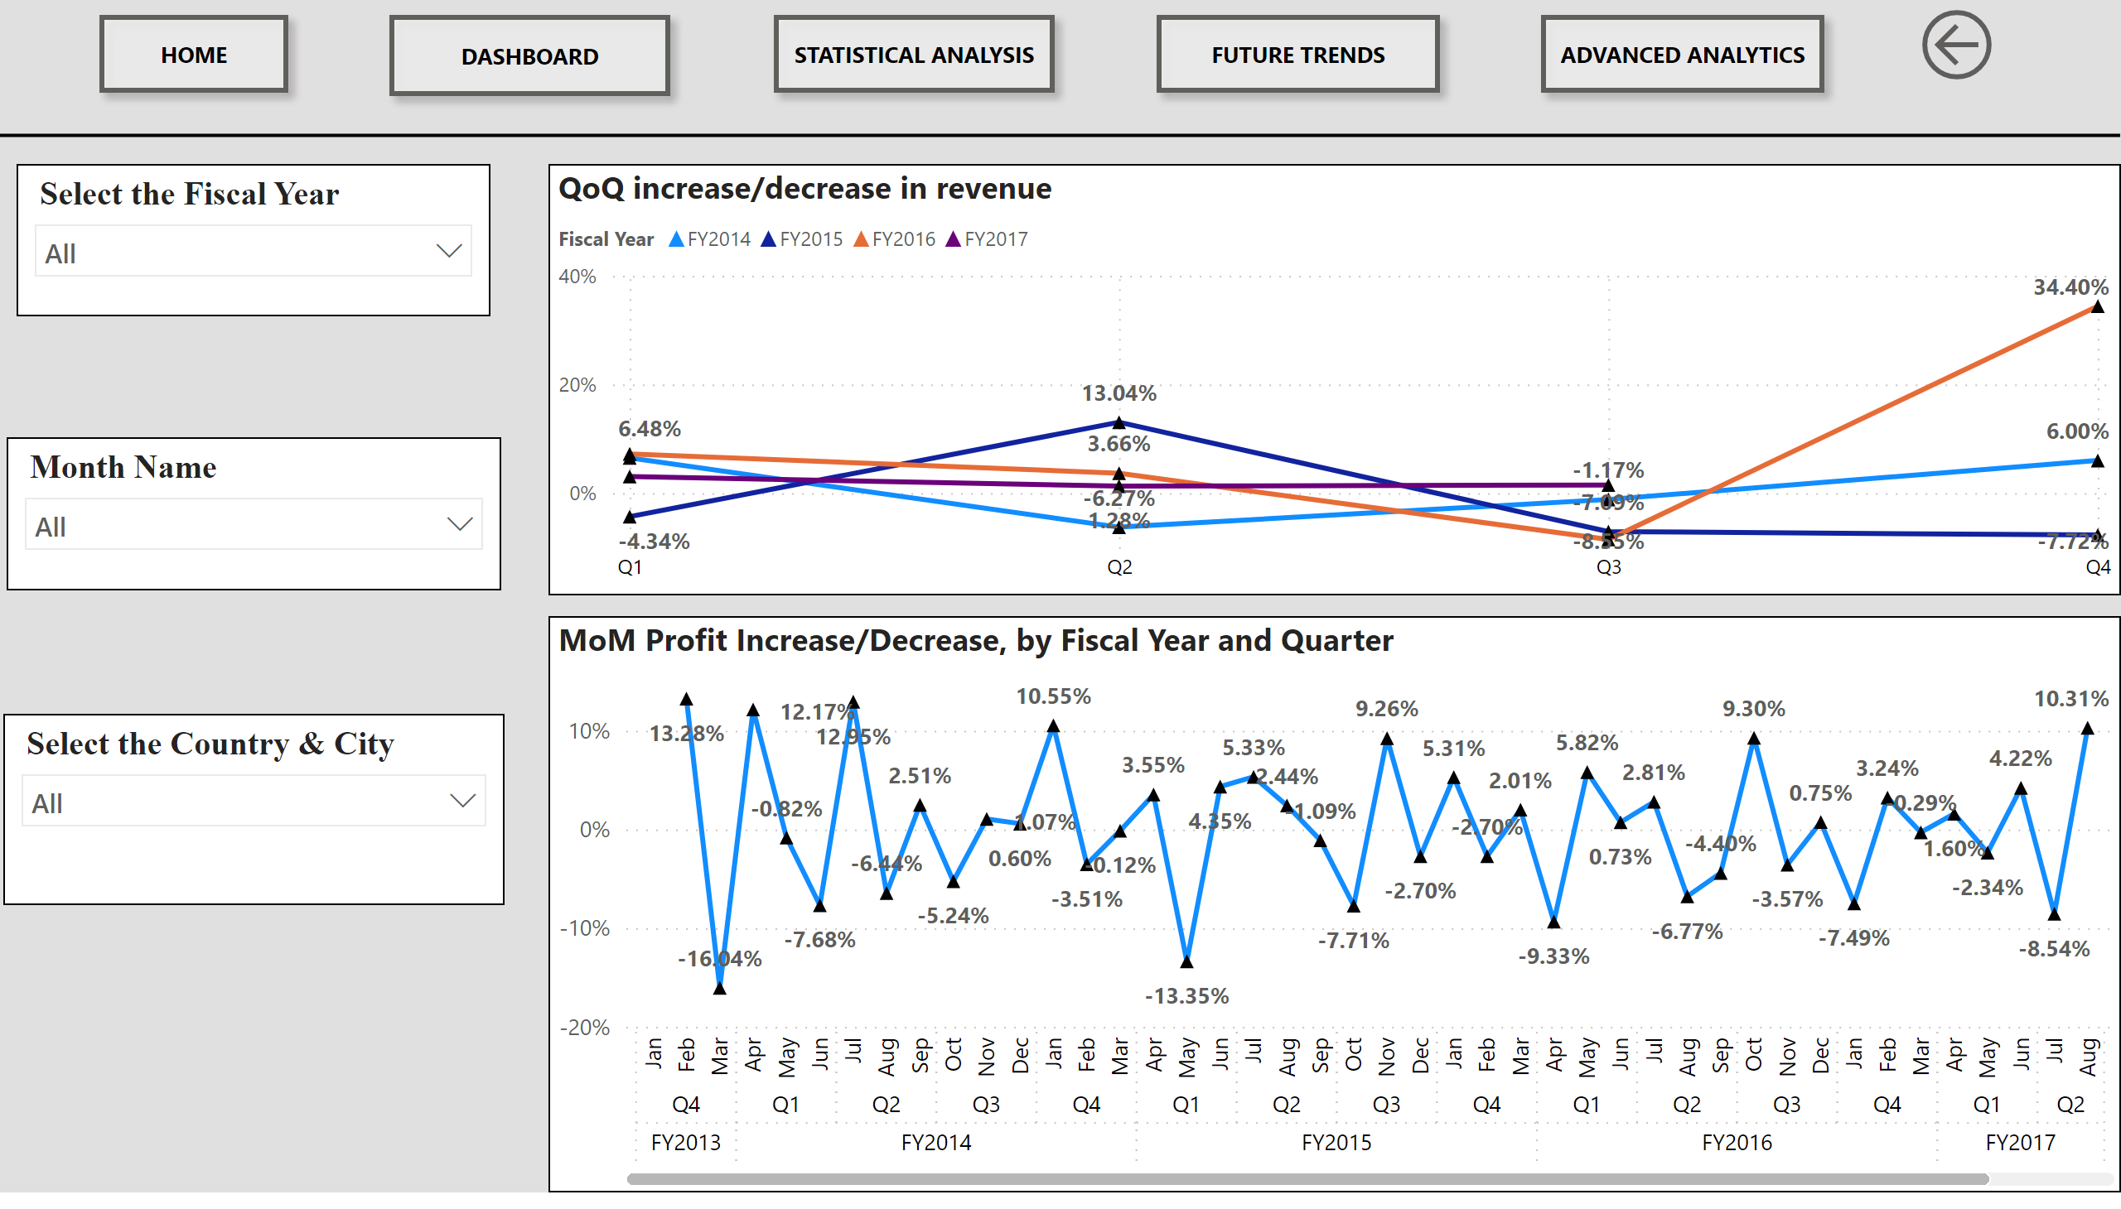
Time Intelligence
Notes:
actionButton
No alt text provided
actionButton
No alt text provided
actionButton
No alt text provided
actionButton
No alt text provided
actionButton
No alt text provided
actionButton
No alt text provided
shape
No alt text provided
MoM Profit Increase/Decrease, by Fiscal Year and Quarter
No alt text provided
slicer
No alt text provided
slicer
No alt text provided
slicer
No alt text provided
QoQ increase/decrease in revenue
No alt text provided

Slide 6
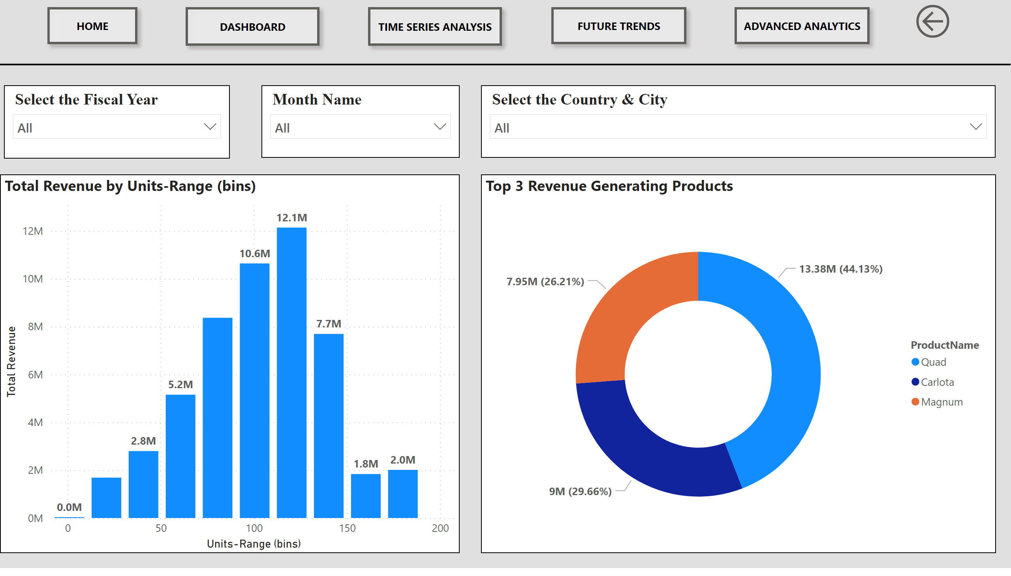
Statistical Analysis
Notes:
actionButton
No alt text provided
actionButton
No alt text provided
actionButton
No alt text provided
actionButton
No alt text provided
actionButton
No alt text provided
actionButton
No alt text provided
shape
No alt text provided
clusteredColumnChart
No alt text provided
Top 3 Revenue Generating Products
No alt text provided
slicer
No alt text provided
slicer
No alt text provided
slicer
No alt text provided

Slide 7
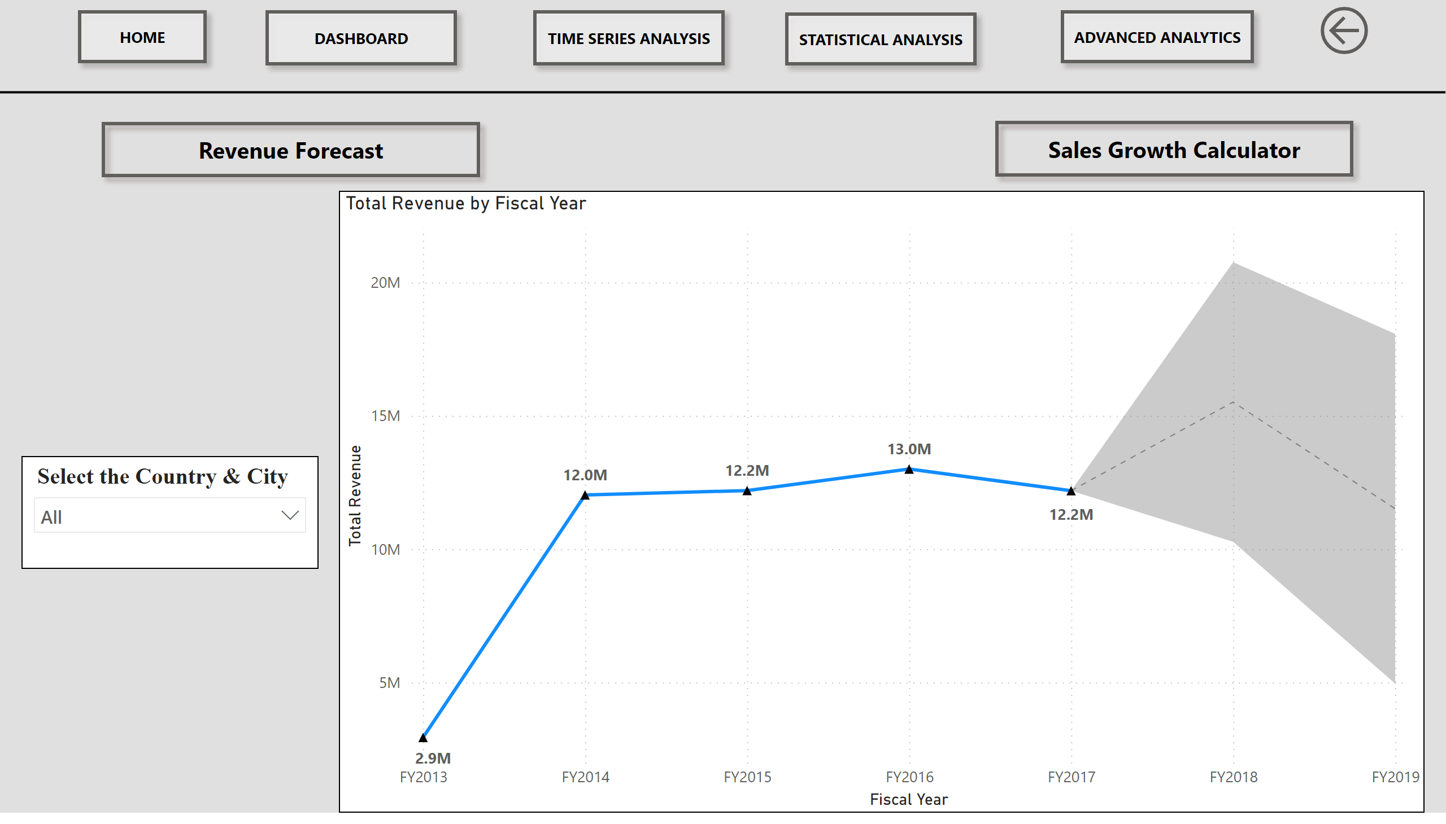
Future Trends
Notes:
actionButton
No alt text provided
actionButton
No alt text provided
actionButton
No alt text provided
actionButton
No alt text provided
actionButton
No alt text provided
actionButton
No alt text provided
shape
No alt text provided
clusteredColumnChart
No alt text provided
slicer
No alt text provided
lineChart
No alt text provided
actionButton
No alt text provided
actionButton
No alt text provided
slicer
No alt text provided

Slide 8
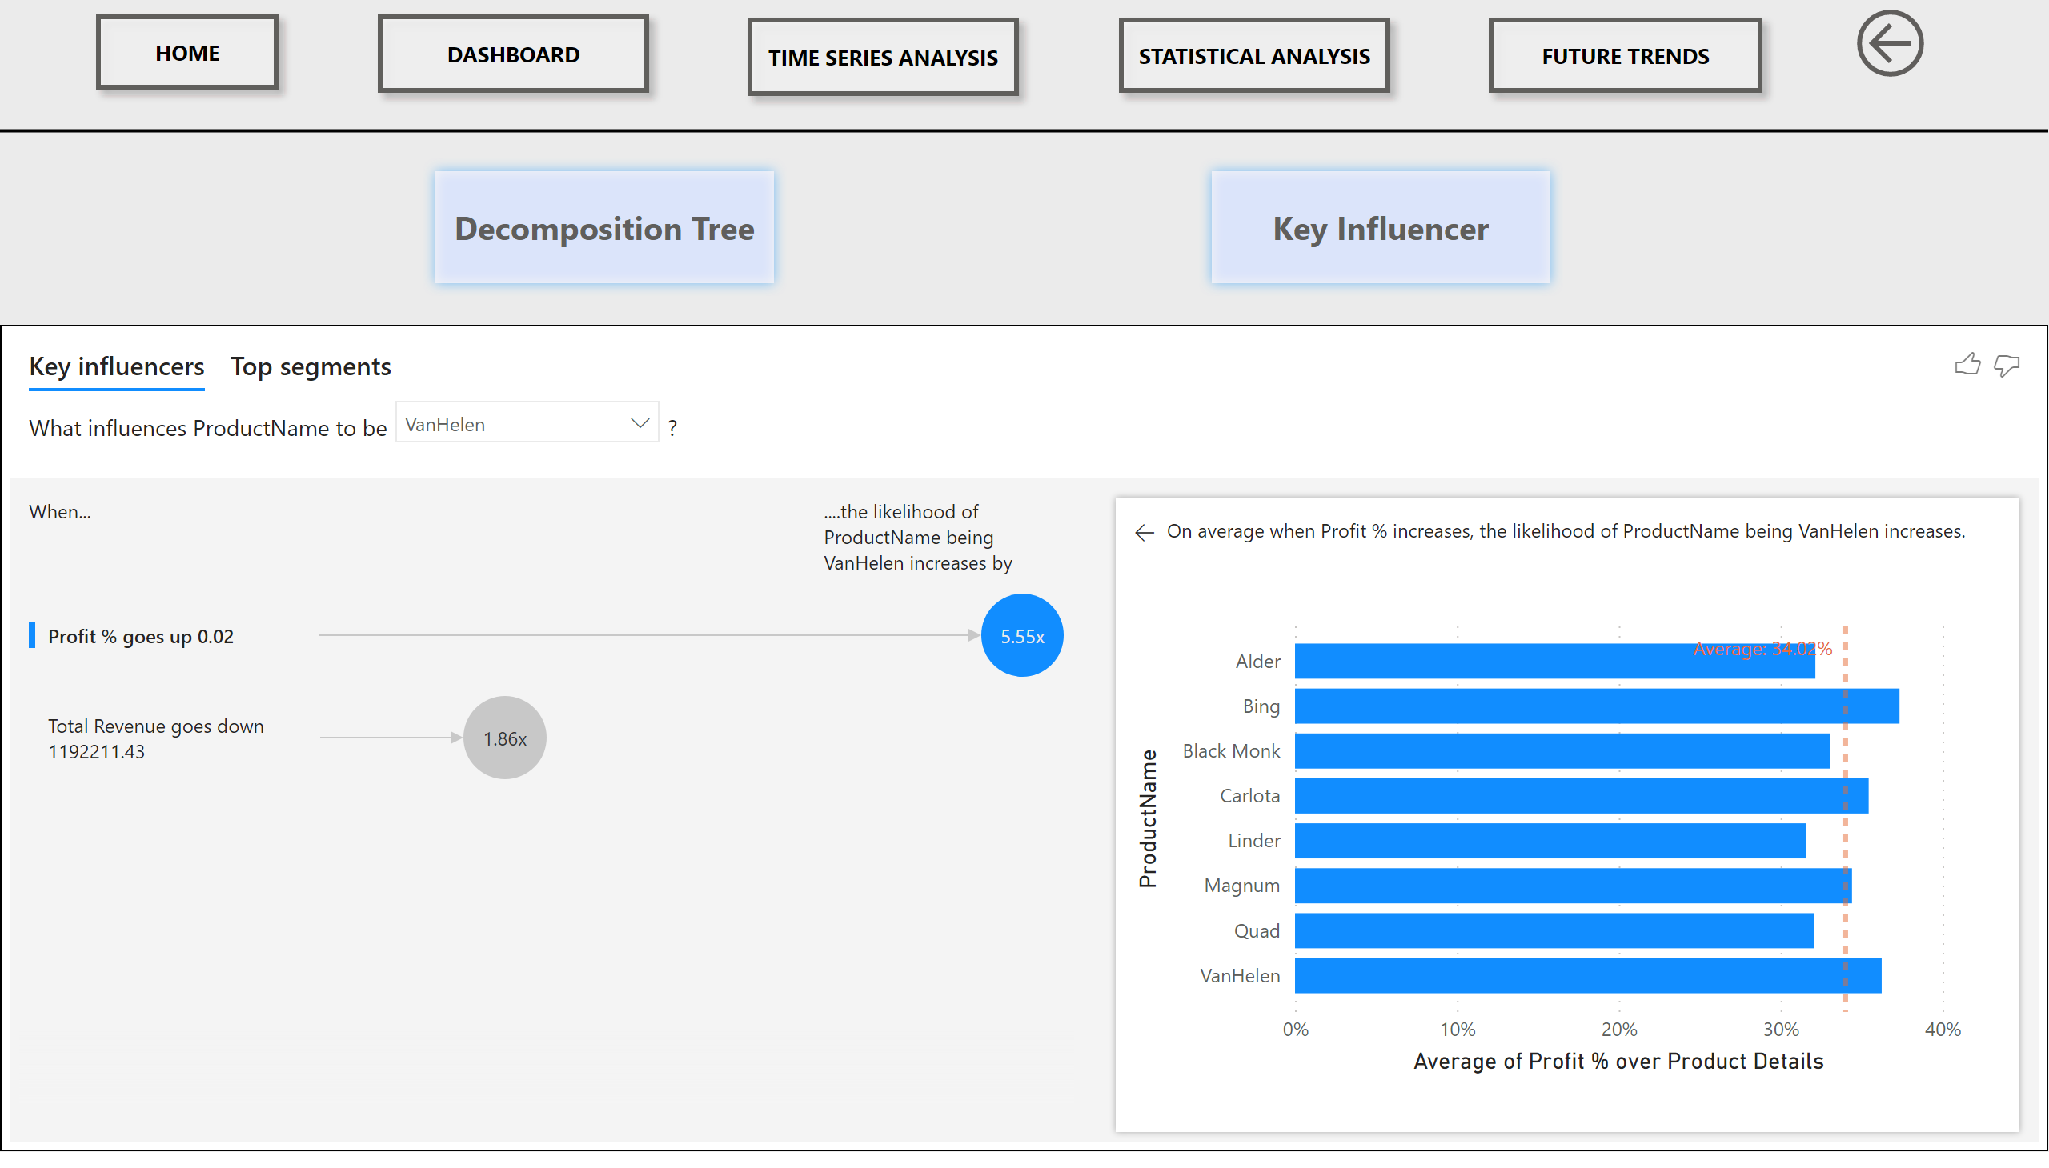
Advanced Analytics
Notes:
actionButton
No alt text provided
actionButton
No alt text provided
actionButton
No alt text provided
actionButton
No alt text provided
actionButton
No alt text provided
actionButton
No alt text provided
shape
No alt text provided
decompositionTreeVisual
No alt text provided
keyDriversVisual
No alt text provided
actionButton
No alt text provided
actionButton
No alt text provided

